Slide 1
WATER QUALITY DATA ANALYTICS
CREATEDBY– SHIVLAL PRASAD AZAD

Slide 2
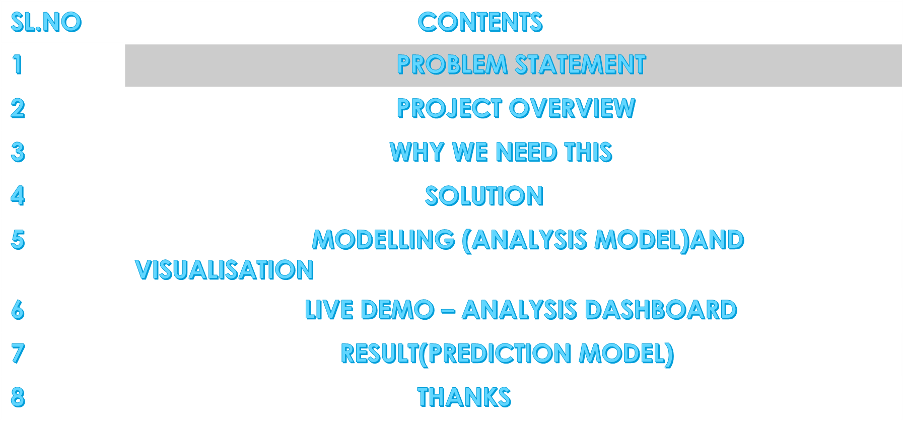
AGENDA

Slide 3

PROBLEM STATEMENT

Slide 4

PROJECT OVERVIEW

Slide 5
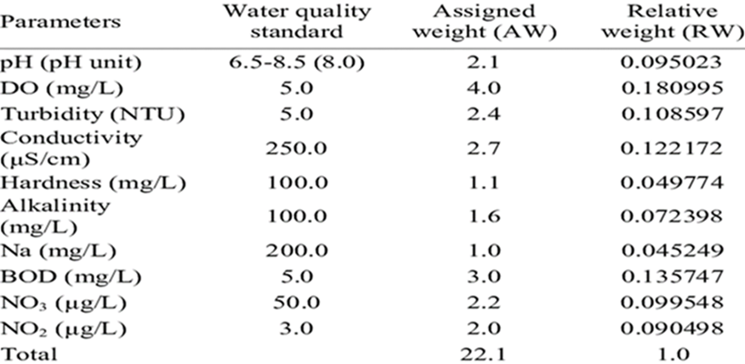

WHY WE NEED THIS?

Slide 6
HOW IT HELP PEOPLE?
Parameters that are frequently sampled or monitored for water quality include temperature, dissolved oxygen, pH, conductivity, ORP, and turbidity. However water monitoring may also include measuring total algae, ISEs (ammonia, nitrate, chloride), or laboratory parameters.
It help people to understand the quality of water is good or bad and also its safe or not. It also help people in agriculture, industry, and electricity etc.

Slide 7
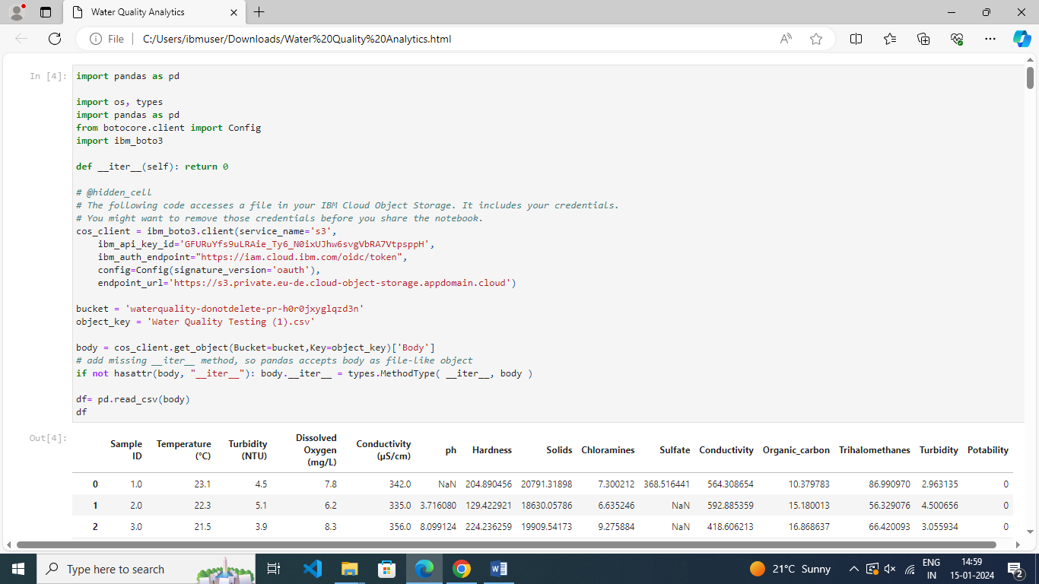
SOLUTION
Address the quality and sustainability of water resources, which are critical to the survival of people and the planet. So we have to check the quality of water for every thing.

Slide 8
MODELLING AND VIRSUALIZATION
IN IBM WE OPEN WATSON STUSIO
THEN WE OPEN JUPYTER EDITOR
THEN UPLOD CSV
RESULT
THEN WE ANALYSE THE DATA

Slide 9
WHO ARE THE END USER?
Industrialization
Household Needs
Agriculture
For hydro-electricity generation
For cooking purpose.
For feeding plants

Slide 10
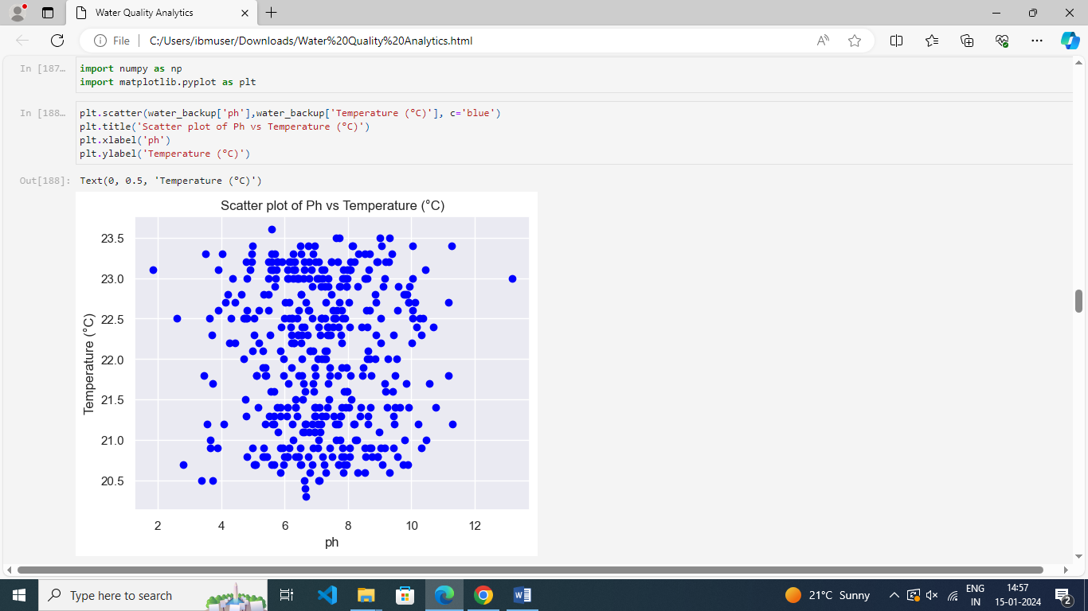
RESULTS

Slide 11
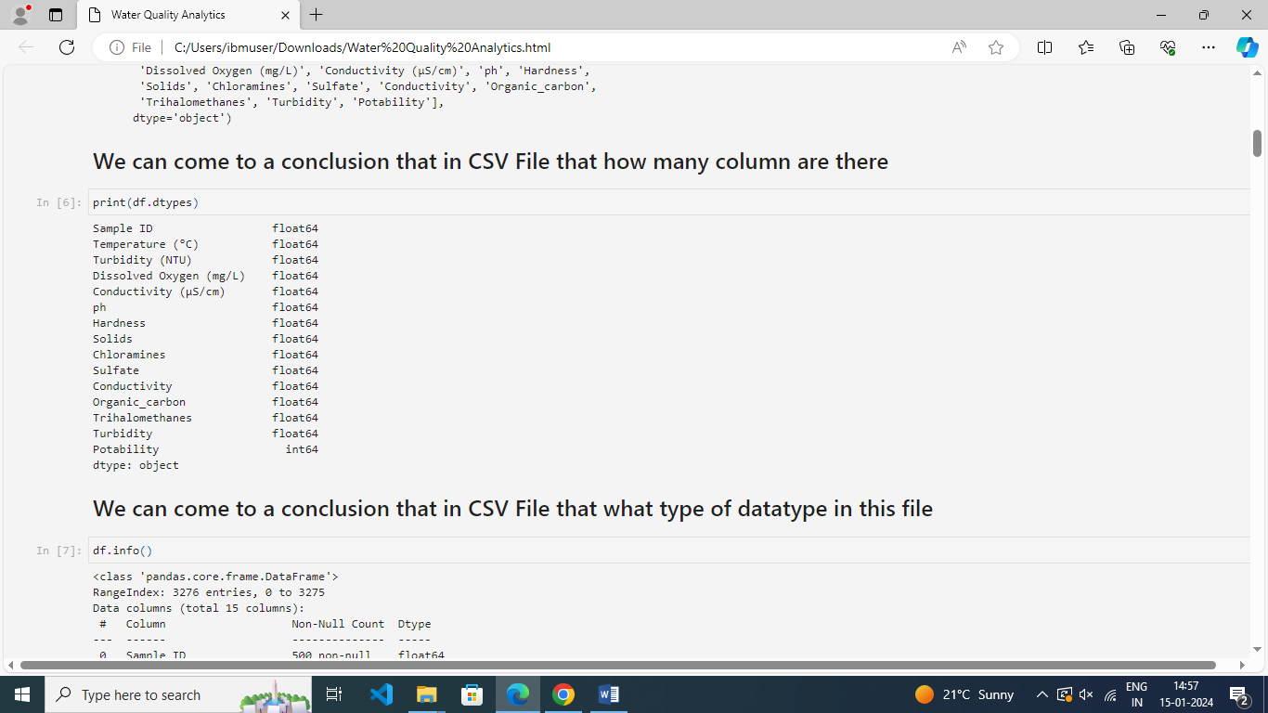
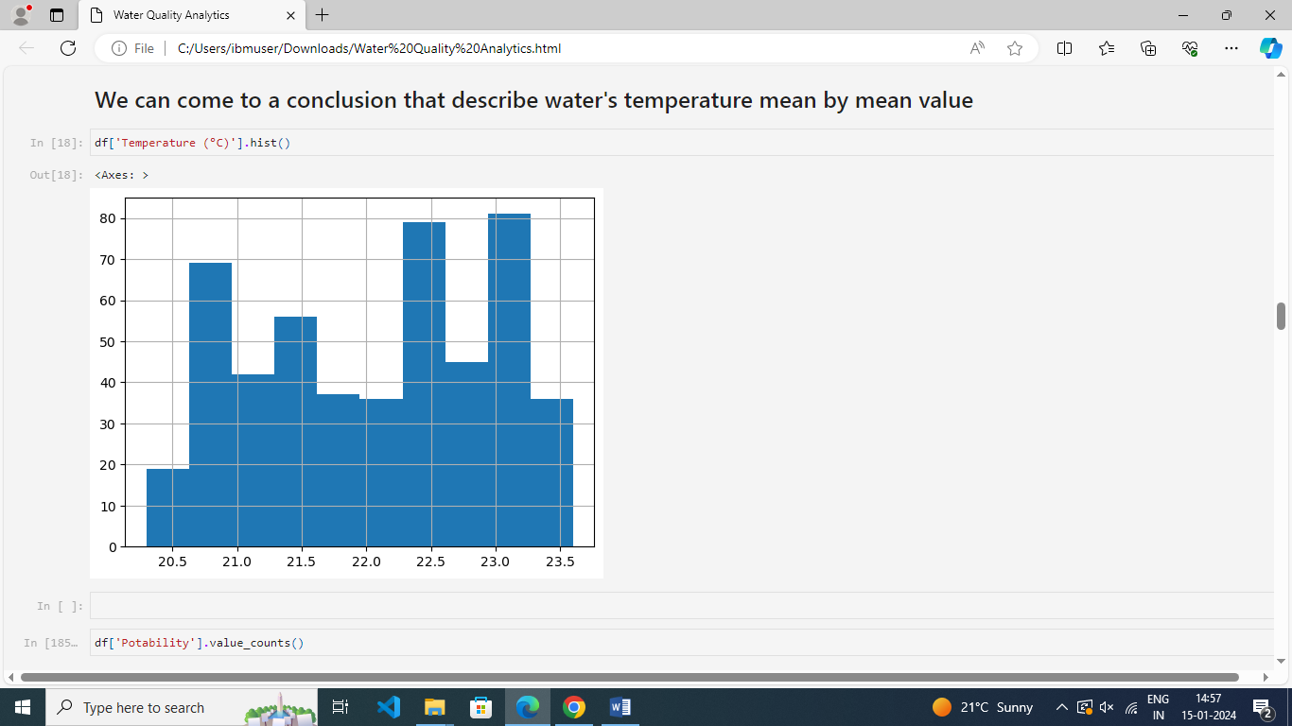

Slide 12
THANK YOU
GUI DED BY :- ARPI TA MAM

